Slide 2
understand the concept of alternate day work,
solve various problems relating to alternate day work.

Slide 3
Alternate Day Work
A & B
Working Alone
Work – A Day Alternately
Starting/Beginning - A
Starting/Beginning - B

Slide 4
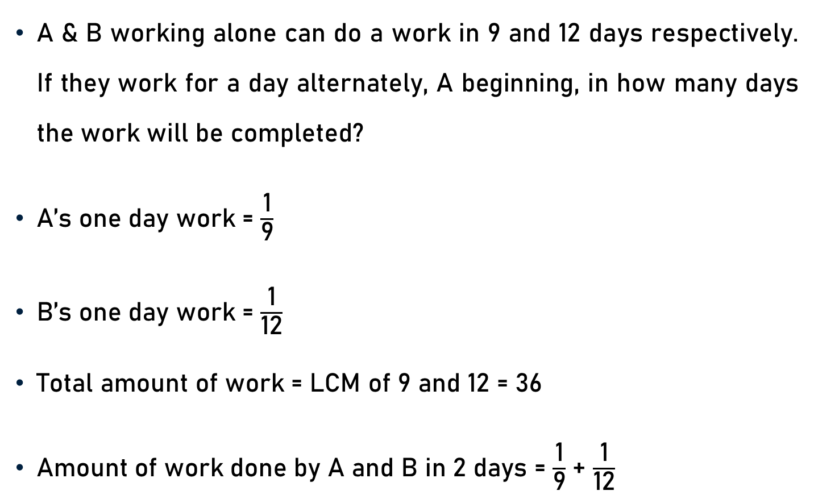
Example 1
A & B working alone can do a work in 9 and 12 days respectively. If they work for a day alternately, A beginning, in how many days the work will be completed?
A’s one day work = $\frac{\text{1}}{\text{9}}$
B’s one day work = $\frac{\text{1}}{\text{1}\text{2}}$
Total amount of work = LCM of 9 and 12 = 36
Amount of work done by A and B in 2 days = $\frac{\text{1}}{\text{9}}$+ $\frac{\text{1}}{\text{12}}$

Slide 5

Example 1
Amount of work done by A and B in 2 days = $\frac{\text{1}}{\text{9}}$+ $\frac{\text{1}}{\text{12}}$
= $\frac{\text{4 + 3}}{\text{36}}$
= $\frac{\text{7}}{\text{36}}$
Amount of work done by A and B in 10 days i.e. 5 x 2 days
= 5 x $\frac{\text{7}}{\text{36}}$
= $\frac{\text{35}}{\text{36}}$

Slide 6
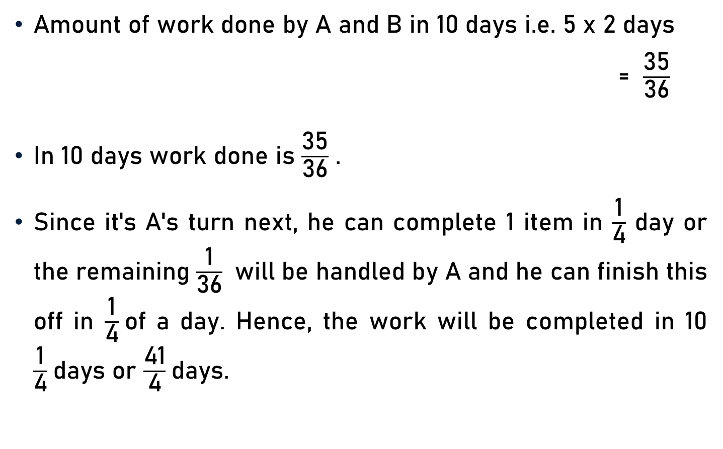
Example 1
Amount of work done by A and B in 10 days i.e. 5 x 2 days
= $\frac{\text{35}}{\text{36}}$
In 10 days work done is $\frac{\text{35}}{\text{36}}$ .
Since it's A's turn next, he can complete 1 item in $\frac{\text{1}}{\text{4}}$ day or the remaining $\frac{\text{1}}{\text{36}}$ will be handled by A and he can finish this off in $\frac{\text{1}}{\text{4}}$of a day. Hence, the work will be completed in 10 $\frac{\text{1}}{\text{4}}$days or $\frac{\text{41}}{\text{4}}$days.

Slide 7
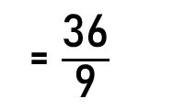
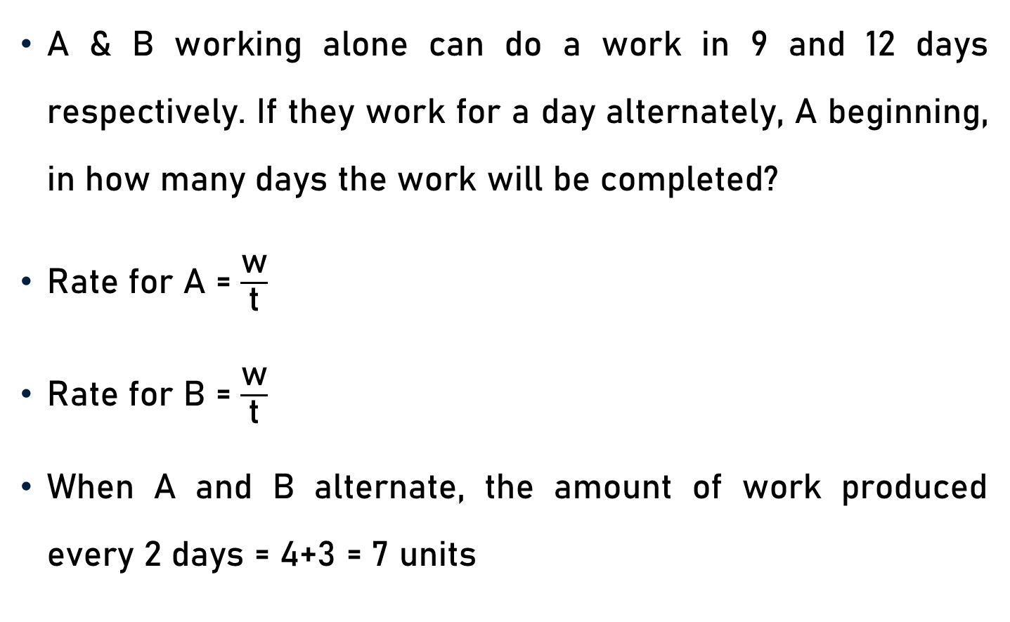
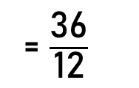
Example 1 – Alternative Method
A & B working alone can do a work in 9 and 12 days respectively. If they work for a day alternately, A beginning, in how many days the work will be completed?
Rate for A = $\frac{\text{w}}{\text{t}}$
Rate for B = $\frac{\text{w}}{\text{t}}$
When A and B alternate, the amount of work produced every 2 days = 4+3 = 7 units
= $\frac{\text{36}}{\text{9}}$
= 4 units per day
= $\frac{\text{36}}{\text{12}}$
= 3 units per day

Slide 8

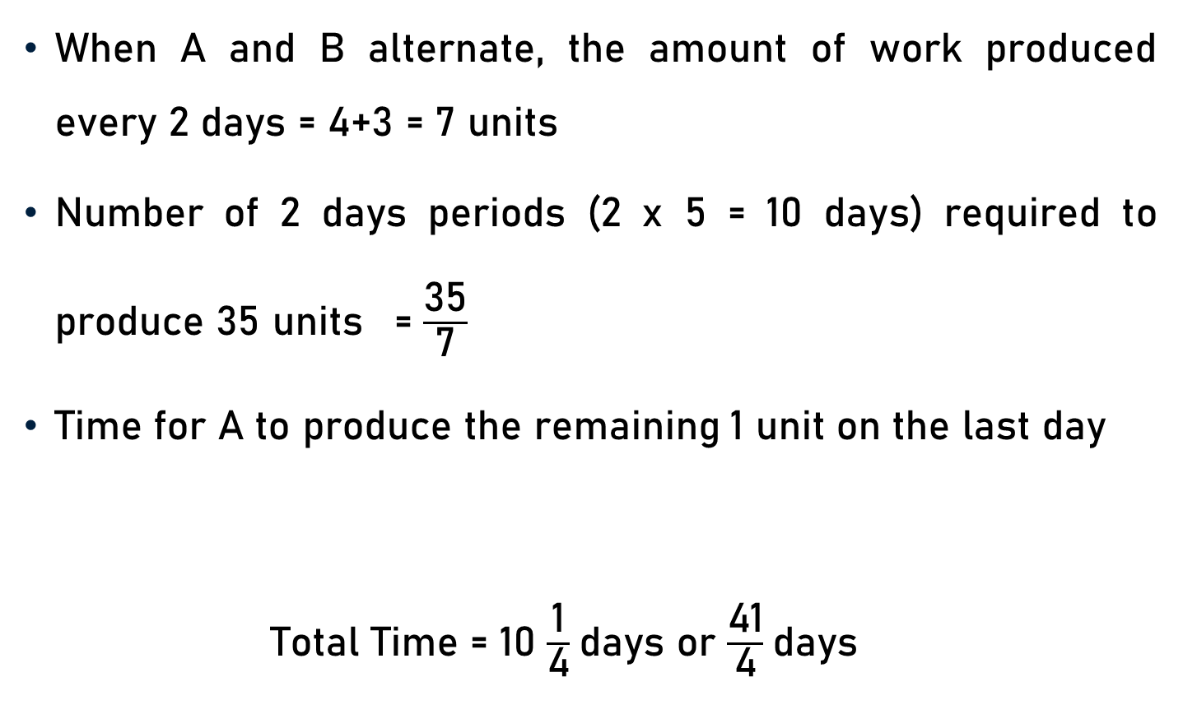
Example 1 – Alternative Method
When A and B alternate, the amount of work produced every 2 days = 4+3 = 7 units
Number of 2 days periods (2 x 5 = 10 days) required to produce 35 units = $\frac{\text{35}}{\text{7}}$
Time for A to produce the remaining 1 unit on the last day
Total Time = 10 $\frac{\text{1}}{\text{4}}$days or $\frac{\text{41}}{\text{4}}$days
and Rate for A (r) = 4
= 5
= $\frac{\text{w}}{\text{r}}$ = $\frac{\text{1}}{\text{4}}$

Slide 9
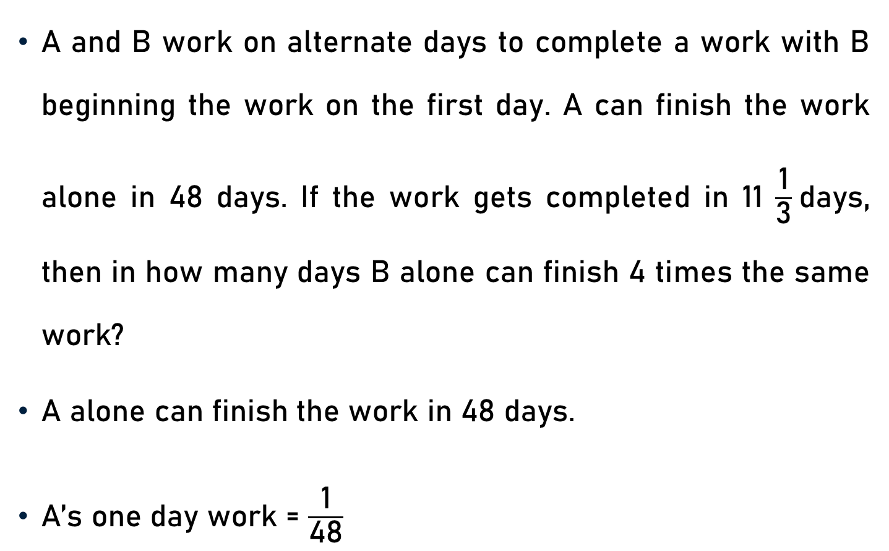
Example 2
A and B work on alternate days to complete a work with B beginning the work on the first day. A can finish the work alone in 48 days. If the work gets completed in 11 $\frac{\text{1}}{\text{3}}$days, then in how many days B alone can finish 4 times the same work?
A alone can finish the work in 48 days.
A’s one day work = $\frac{\text{1}}{\text{48}}$

Slide 10
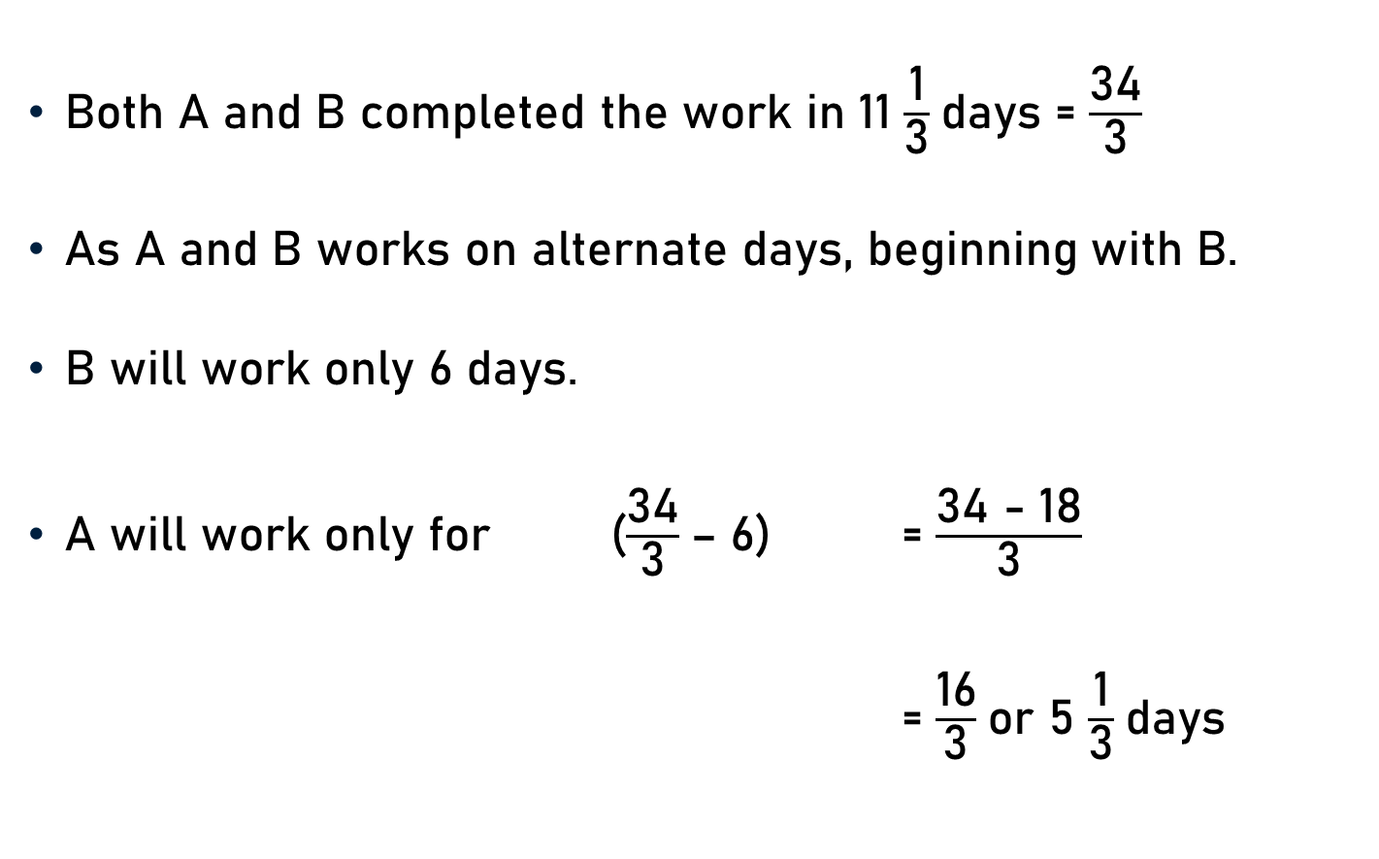
Example 2
Both A and B completed the work in 11 $\frac{\text{1}}{\text{3}}$days = $\frac{\text{34}}{\text{3}}$
As A and B works on alternate days, beginning with B.
B will work only 6 days.
A will work only for ($\frac{\text{34}}{\text{3}}$– 6) = $\frac{\text{34}\text{ − 18}}{\text{3}}$
= $\frac{\text{16}}{\text{3}}$or 5 $\frac{\text{1}}{\text{3}}$days

Slide 11
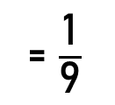
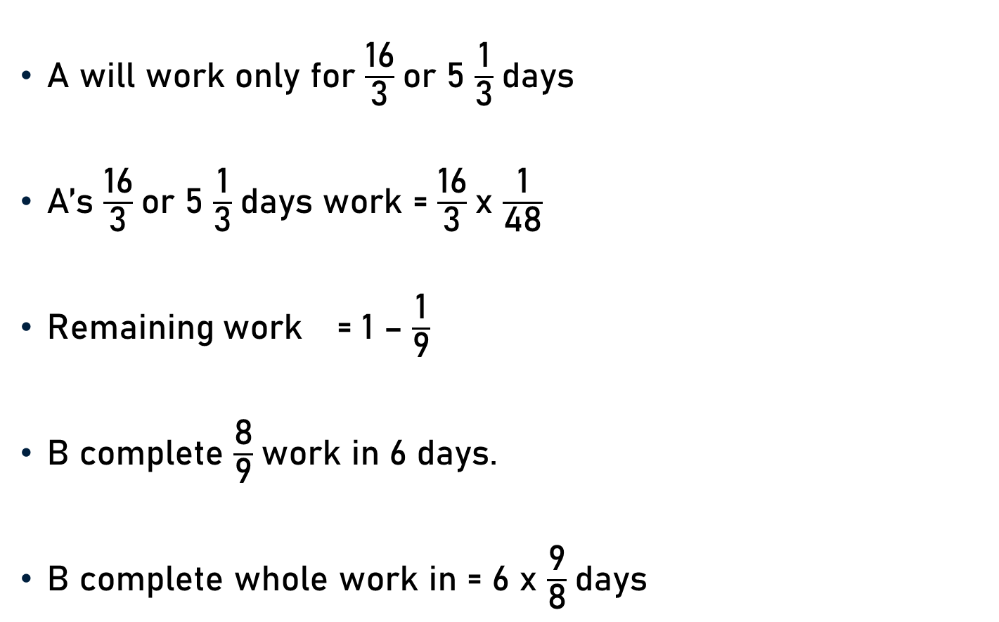

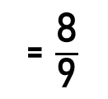
Example 2
A will work only for $\frac{\text{16}}{\text{3}}$or 5 $\frac{\text{1}}{\text{3}}$days
A’s $\frac{\text{16}}{\text{3}}$or 5 $\frac{\text{1}}{\text{3}}$days work = $\frac{\text{16}}{\text{3}}$x $\frac{\text{1}}{\text{48}}$
Remaining work = 1 – $\frac{\text{1}}{\text{9}}$
B complete $\frac{\text{8}}{\text{9}}$work in 6 days.
B complete whole work in = 6 x $\frac{\text{9}}{\text{8}}$days
= $\frac{\text{1}}{\text{9}}$
3
= $\frac{\text{8}}{\text{9}}$
3
= $\frac{\text{27}}{\text{4}}$days
4

Slide 12

Example 2
B complete whole work in $\frac{\text{27}}{\text{4}}$days.
B alone can finish 4 times the same work in
= 4 x $\frac{\text{27}}{\text{4}}$
= 27 days

Slide 13
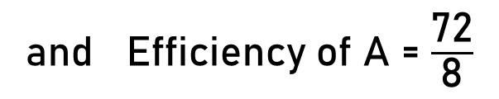
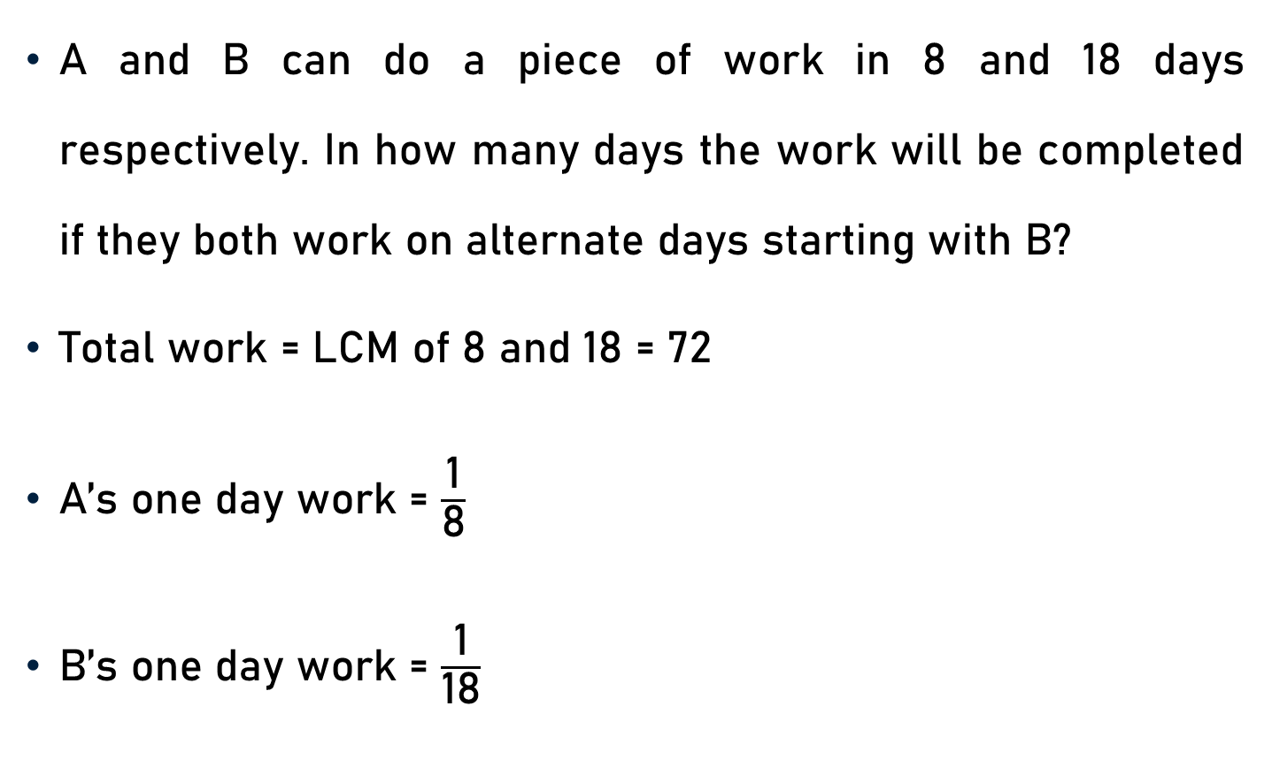
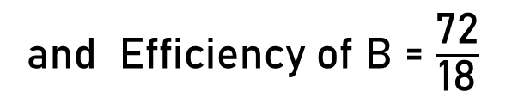
Example 3
A and B can do a piece of work in 8 and 18 days respectively. In how many days the work will be completed if they both work on alternate days starting with B?
Total work = LCM of 8 and 18 = 72
A’s one day work = $\frac{\text{1}}{\text{8}}$
B’s one day work = $\frac{\text{1}}{\text{18}}$
9
and Efficiency of A = $\frac{\text{72}}{\text{8}}$
= 9
4
and Efficiency of B = $\frac{\text{72}}{\text{18}}$
= 4

Slide 14
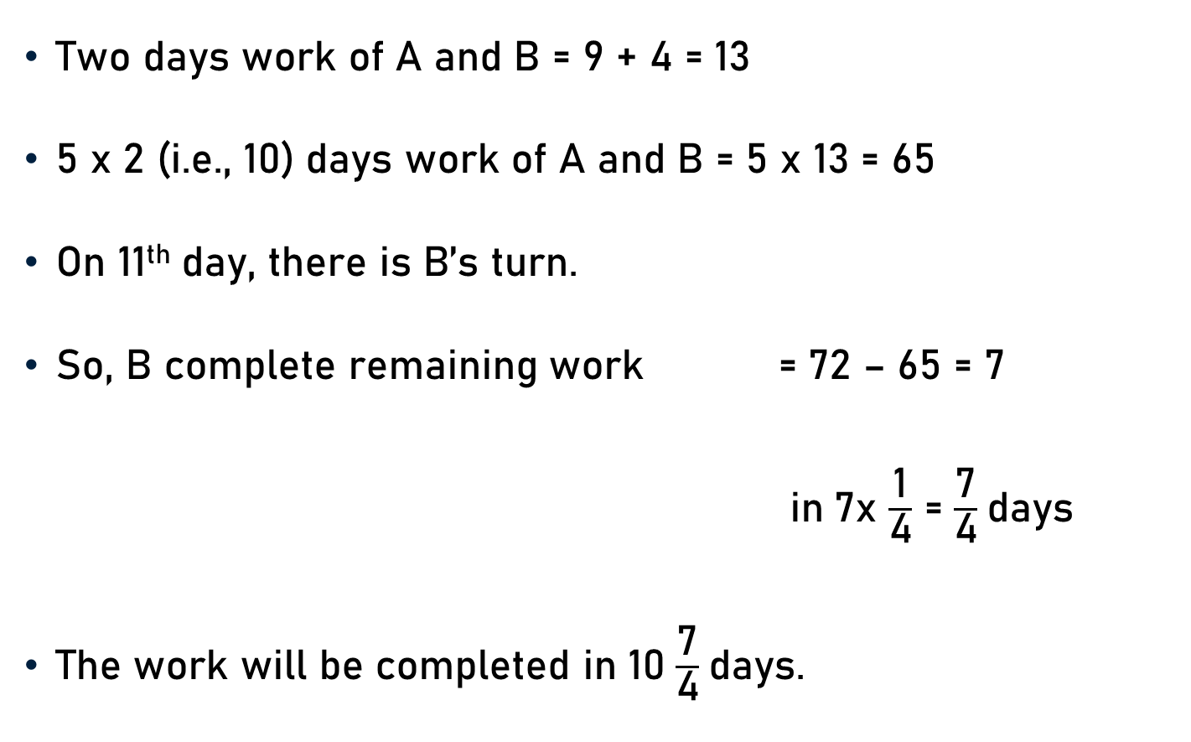
Example 3
Two days work of A and B = 9 + 4 = 13
5 x 2 (i.e., 10) days work of A and B = 5 x 13 = 65
On 11th day, there is B’s turn.
So, B complete remaining work = 72 – 65 = 7
in 7x $\frac{\text{1}}{\text{4}}$ = $\frac{\text{7}}{\text{4}}$days
The work will be completed in 10 $\frac{\text{7}}{\text{4}}$days.

Slide 15
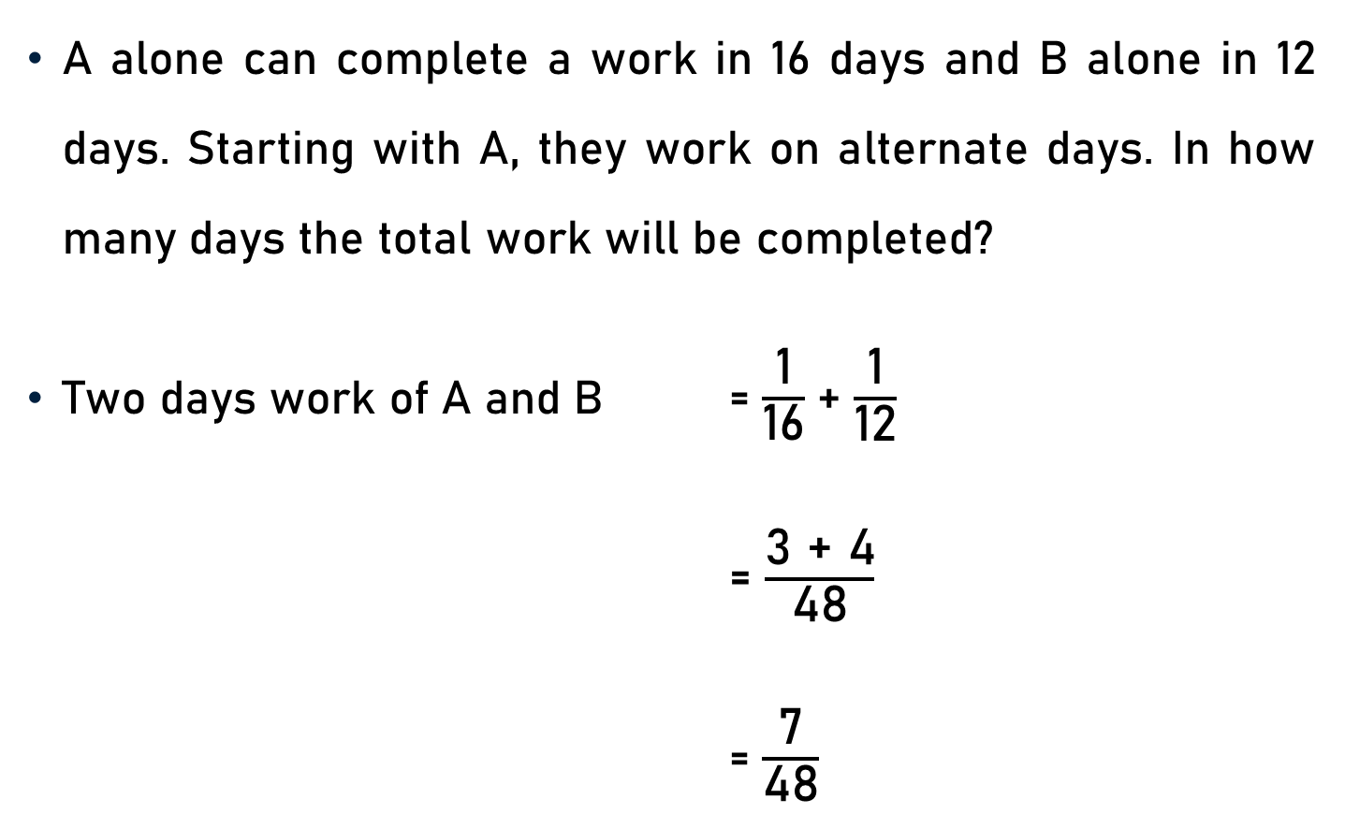
Example 4
A alone can complete a work in 16 days and B alone in 12 days. Starting with A, they work on alternate days. In how many days the total work will be completed?
Two days work of A and B = $\frac{\text{1}}{\text{16}}$+ $\frac{\text{1}}{\text{12}}$
= $\frac{\text{3 + 4}}{\text{48}}$
= $\frac{\text{7}}{\text{48}}$

Slide 16
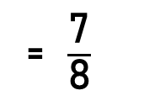
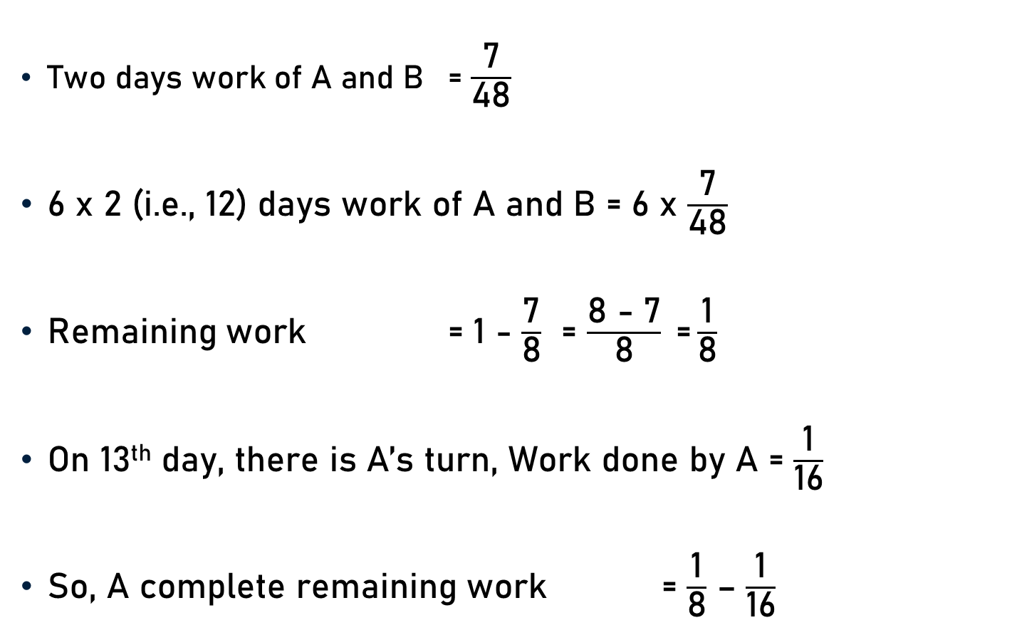
Example 4
Two days work of A and B = $\frac{\text{7}}{\text{48}}$
6 x 2 (i.e., 12) days work of A and B = 6 x $\frac{\text{7}}{\text{48}}$
Remaining work = 1 - $\frac{\text{7}}{\text{8}}$ = $\frac{\text{8 − 7}}{\text{8}} \text{=}\frac{\text{1}}{\text{8}}$
On 13th day, there is A’s turn, Work done by A = $\frac{\text{1}}{\text{16}}$
So, A complete remaining work = $\frac{\text{1}}{\text{8}}$ – $\frac{\text{1}}{\text{16}}$
= $\frac{\text{7}}{\text{8}}$
8

Slide 17
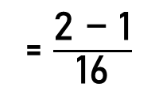
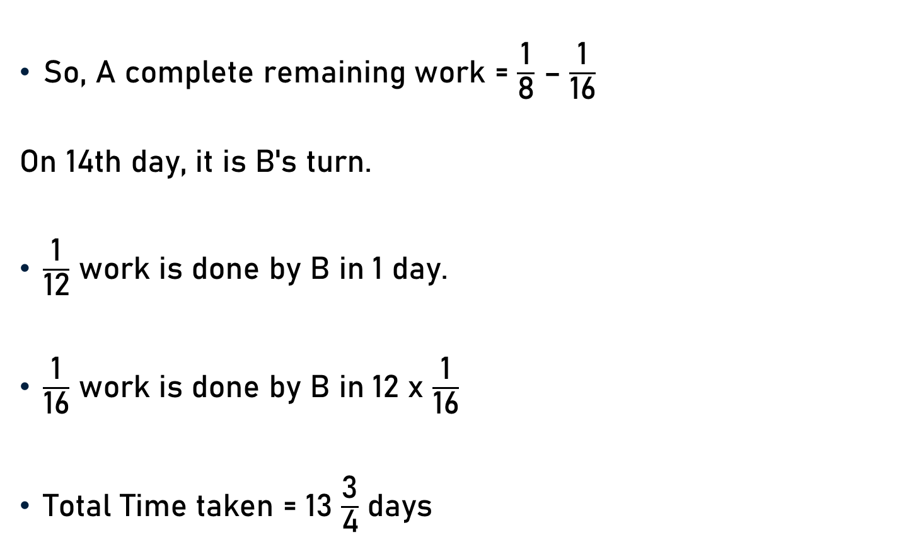

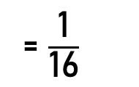
Example 4
So, A complete remaining work = $\frac{\text{1}}{\text{8}}$ – $\frac{\text{1}}{\text{16}}$
On 14th day, it is B's turn.
$\frac{\text{1}}{\text{12}}$ work is done by B in 1 day.
$\frac{\text{1}}{\text{16}}$ work is done by B in 12 x $\frac{\text{1}}{\text{16}}$
Total Time taken = 13 $\frac{\text{3}}{\text{4}}$ days
= $\frac{\text{2 − 1}}{\text{16}}$
= $\frac{\text{1}}{\text{16}}$
3
= $\frac{\text{3}}{\text{4}}$ days
4

Slide 18
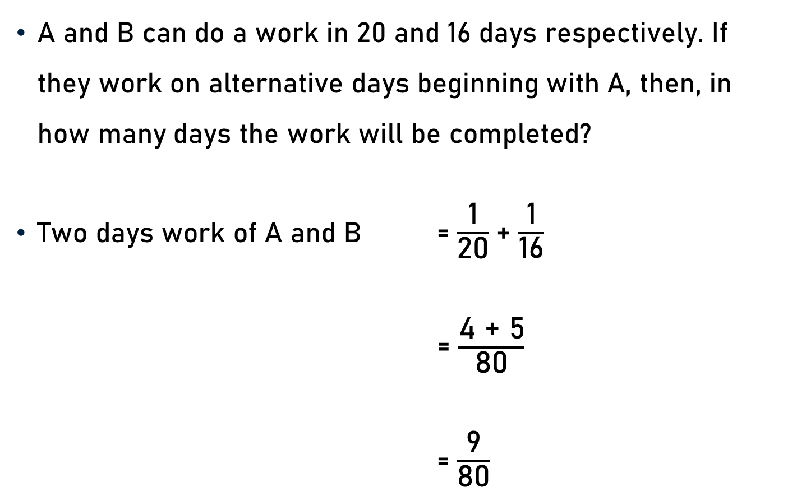
Example 5
A and B can do a work in 20 and 16 days respectively. If they work on alternative days beginning with A, then, in how many days the work will be completed?
Two days work of A and B = $\frac{\text{1}}{\text{20}}$+ $\frac{\text{1}}{\text{16}}$
= $\frac{\text{4 + 5}}{\text{80}}$
= $\frac{\text{9}}{\text{80}}$

Slide 19
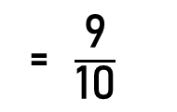
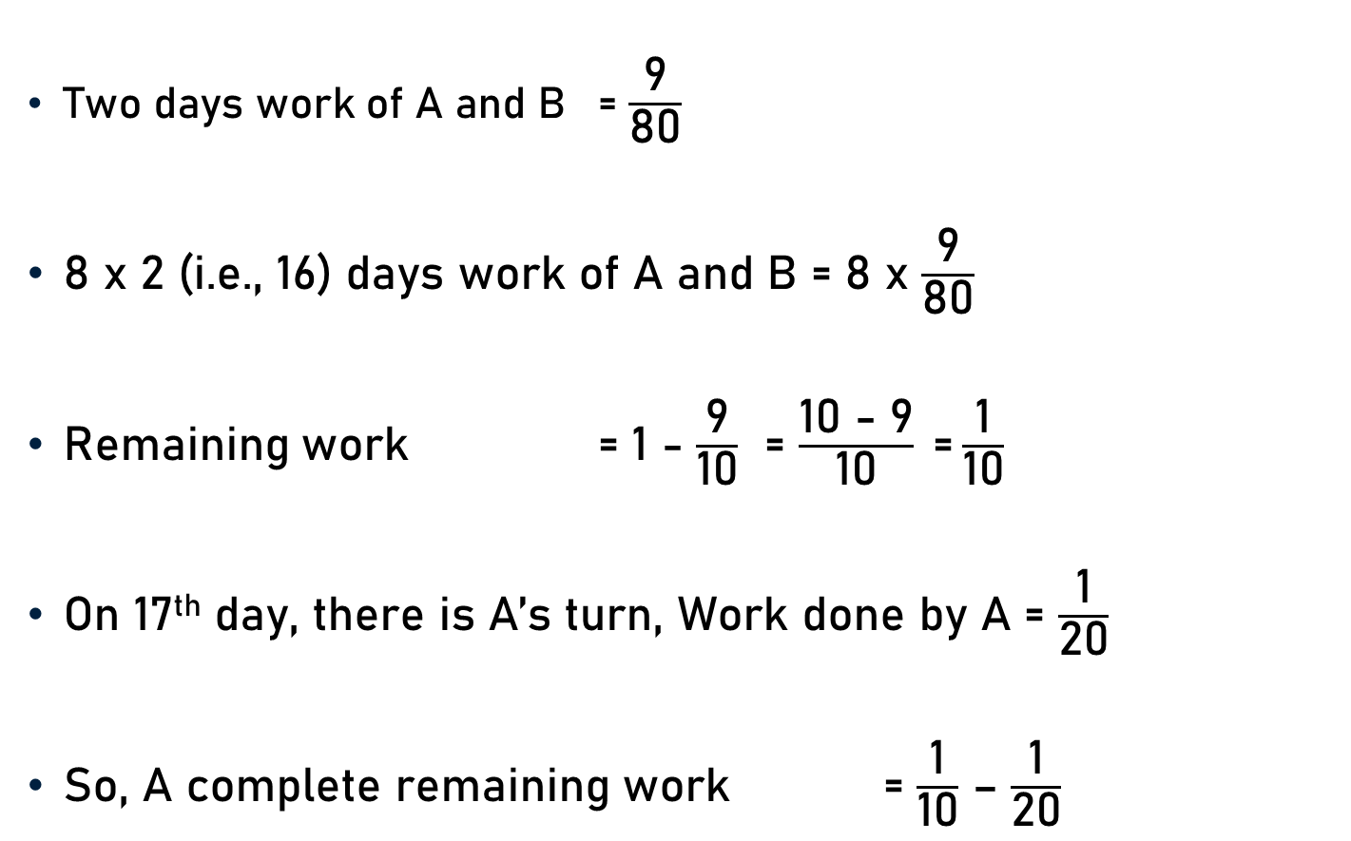
Example 5
Two days work of A and B = $\frac{\text{9}}{\text{80}}$
8 x 2 (i.e., 16) days work of A and B = 8 x $\frac{\text{9}}{\text{80}}$
Remaining work = 1 - $\frac{\text{9}}{\text{10}}$ = $\frac{\text{10 − 9}}{\text{10}} \text{=}\frac{\text{1}}{\text{10}}$
On 17th day, there is A’s turn, Work done by A = $\frac{\text{1}}{\text{20}}$
So, A complete remaining work = $\frac{\text{1}}{\text{10}}$ – $\frac{\text{1}}{\text{20}}$
= $\frac{\text{9}}{\text{10}}$
10

Slide 20
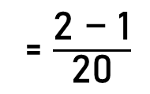
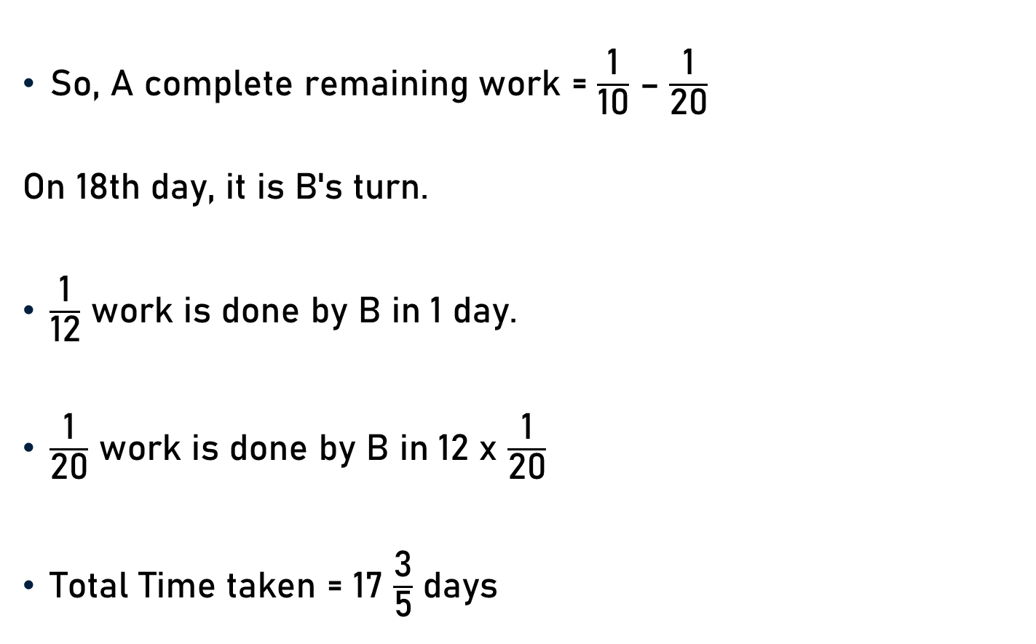
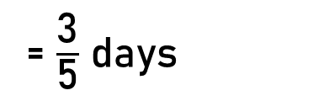
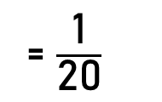
Example 5
So, A complete remaining work = $\frac{\text{1}}{\text{10}}$ – $\frac{\text{1}}{\text{20}}$
On 18th day, it is B's turn.
$\frac{\text{1}}{\text{12}}$ work is done by B in 1 day.
$\frac{\text{1}}{\text{20}}$ work is done by B in 12 x $\frac{\text{1}}{\text{20}}$
Total Time taken = 17 $\frac{\text{3}}{\text{5}}$ days
= $\frac{\text{2 − 1}}{\text{20}}$
= $\frac{\text{1}}{\text{20}}$
3
= $\frac{\text{3}}{\text{5}}$ days
5

Slide 21
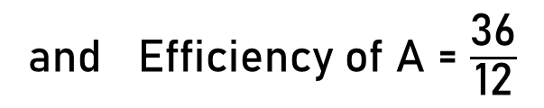

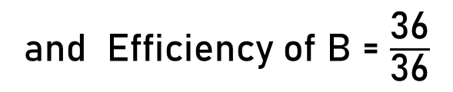
Example 6
A and B can do a work in 12 and 36 days respectively. If they work on alternative days beginning with B, then, in how many days the work will be completed?
Total work = LCM of 12 and 36 = 36
A’s one day work = $\frac{\text{1}}{\text{12}}$
B’s one day work = $\frac{\text{1}}{\text{36}}$
3
and Efficiency of A = $\frac{\text{36}}{\text{12}}$
= 3
4
and Efficiency of B = $\frac{\text{36}}{\text{36}}$
= 1

Slide 22
Example 6
Two days work of A and B = 3 + 1 = 4
9 x 2 (i.e., 18) days work of A and B = 9 x 4 = 36
Remaining work = 36 – 36 = 0
The work will be completed in 18 days.

Slide 23
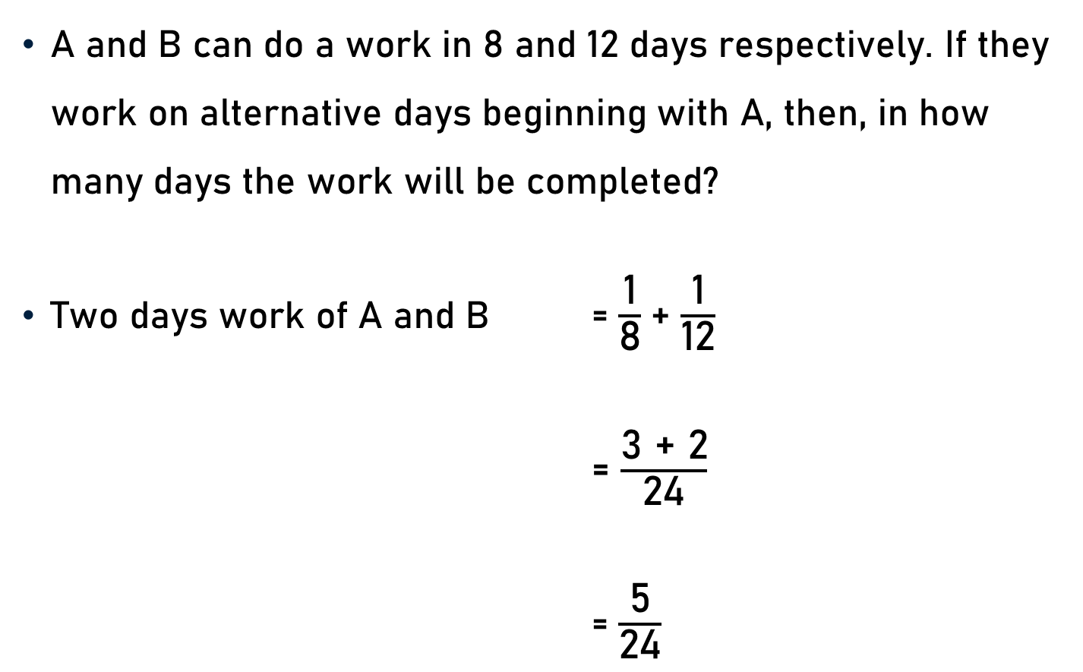
Example 7
A and B can do a work in 8 and 12 days respectively. If they work on alternative days beginning with A, then, in how many days the work will be completed?
Two days work of A and B = $\frac{\text{1}}{\text{8}}$+ $\frac{\text{1}}{\text{12}}$
= $\frac{\text{3 + 2}}{\text{24}}$
= $\frac{\text{5}}{\text{24}}$

Slide 24
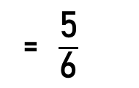
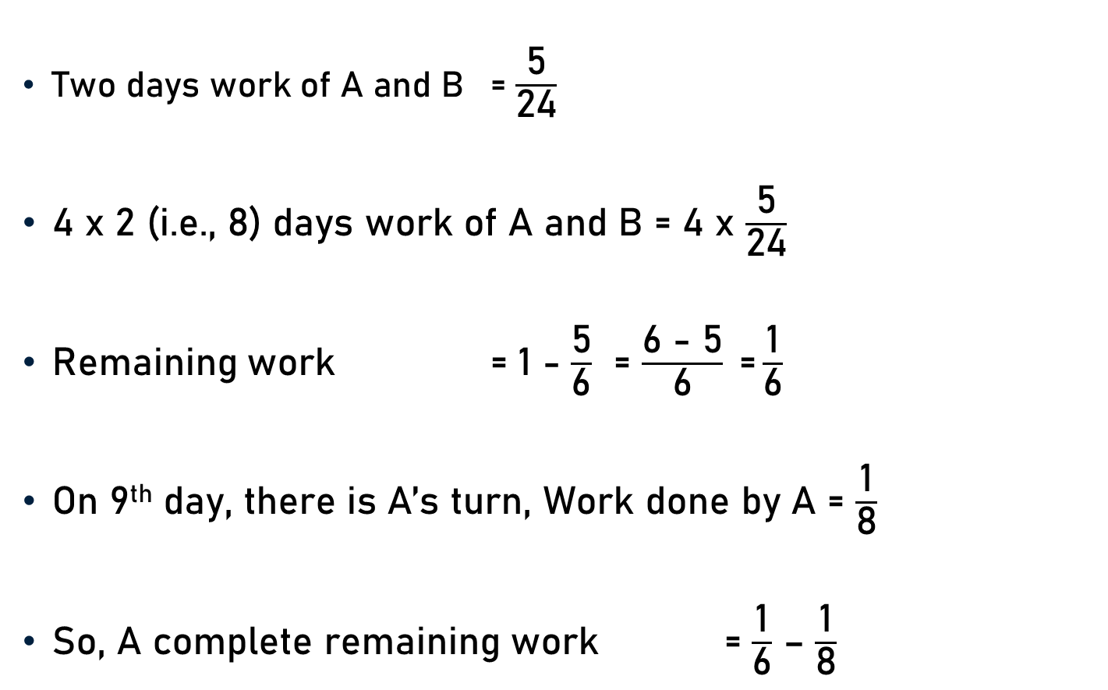
Example 7
Two days work of A and B = $\frac{\text{5}}{\text{24}}$
4 x 2 (i.e., 8) days work of A and B = 4 x $\frac{\text{5}}{\text{24}}$
Remaining work = 1 - $\frac{\text{5}}{\text{6}}$ = $\frac{\text{6 − 5}}{\text{6}} \text{=}\frac{\text{1}}{\text{6}}$
On 9th day, there is A’s turn, Work done by A = $\frac{\text{1}}{\text{8}}$
So, A complete remaining work = $\frac{\text{1}}{\text{6}}$ – $\frac{\text{1}}{\text{8}}$
= $\frac{\text{5}}{\text{6}}$
6

Slide 25
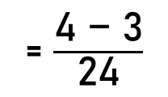


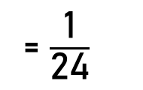
Example 7
So, A complete remaining work = $\frac{\text{1}}{\text{6}}$ – $\frac{\text{1}}{\text{8}}$
On 10th day, it is B's turn.
$\frac{\text{1}}{\text{12}}$ work is done by B in 1 day.
$\frac{\text{1}}{\text{24}}$ work is done by B in 12 x $\frac{\text{1}}{\text{24}}$
Total Time taken = 9 $\frac{\text{1}}{\text{2}}$ days
= $\frac{\text{4}\text{ − }\text{3}}{\text{24}}$
= $\frac{\text{1}}{\text{24}}$
1
= $\frac{\text{1}}{\text{2}}$ days
2

Slide 26
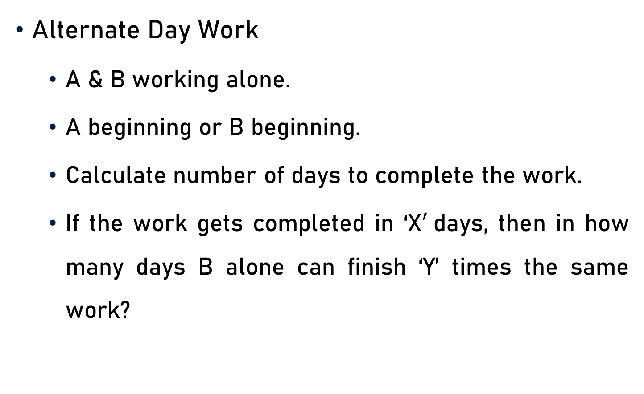
Conclusion
Alternate Day Work
  A & B working alone.
  A beginning or B beginning.
  Calculate number of days to complete the work.
  If the work gets completed in ‘X$′$days, then in how many days B alone can finish ‘Y’ times the same work?

Slide 27
Summary
Time and Work
    Alternate Day Work

